Slide 1
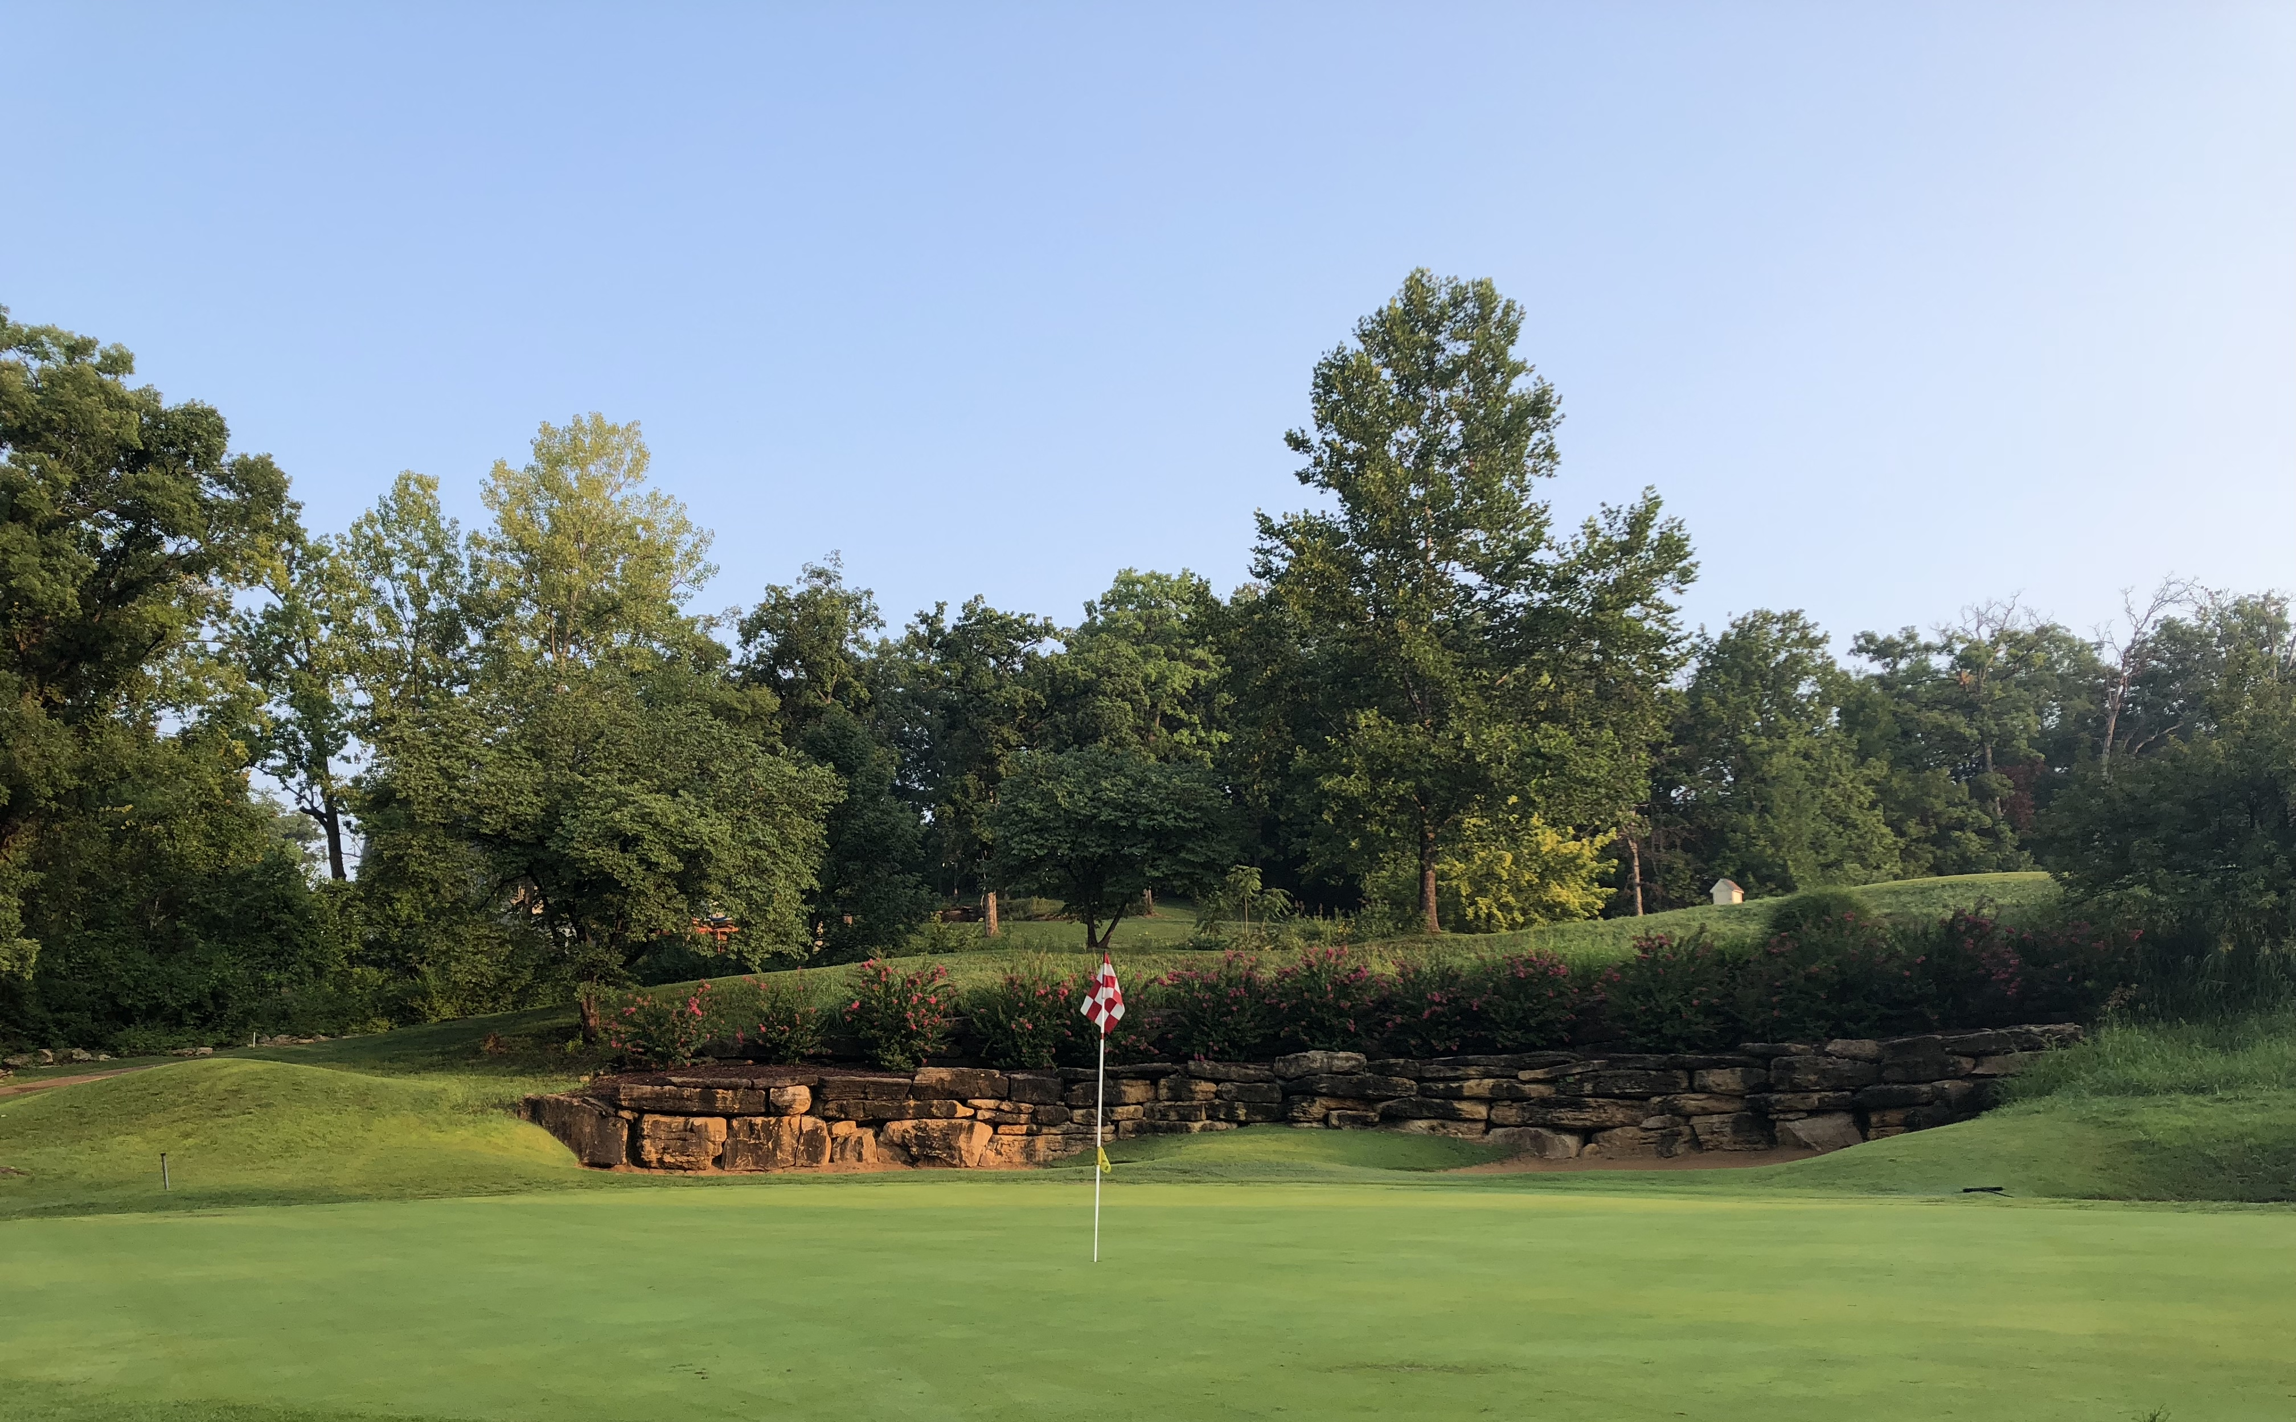
Tapawingo National Golf Club
2019 Corporate Advertising Package

Slide 2
Tapawingo National Golf Club
At Tapawingo National Golf Club, the three 9-hole golf courses cover more than 150 acres. The course is surrounded by mature trees, complimented by beautiful water features and boasts the right amount of challenge. In 2018, the course has played host to 34,000 rounds of golf. This includes:
18 holes of play
9 hole rounds
League play
40+ corporate / charity outings
2019 Corporate Advertising Package

Slide 3
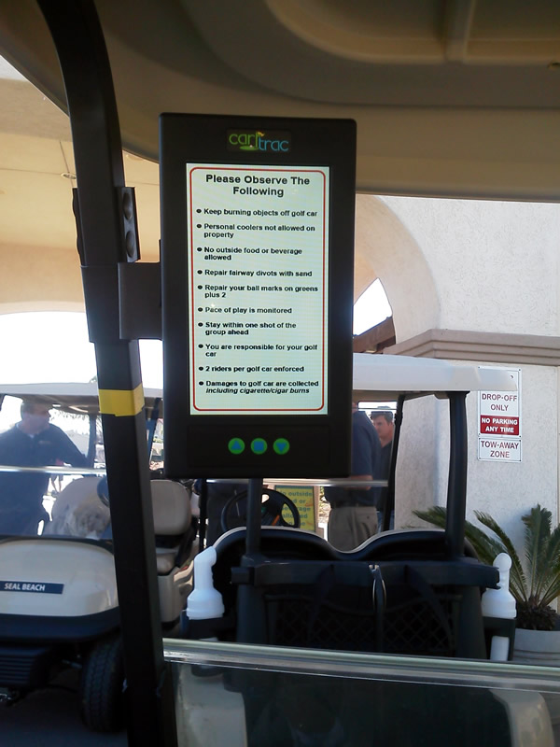
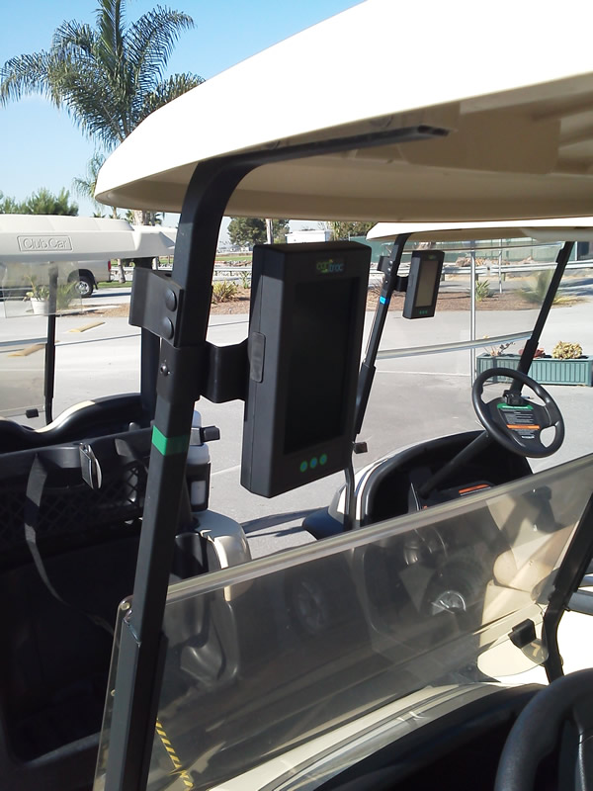
Tapawingo National Golf club
To provide our players with a better golf experience, Tapawingo will be installing CartTrac GPS units to all 100 golf carts. This state-of-the-art system provides golfers with useful information including color 3-D graphics of each hole and accurate yardage information.
2019 Corporate Advertising Package

Slide 4
Tapawingo national golf club
The 7-inch, high resolution screens provide a unique advertising opportunity to reach a very attractive demographic. By reaching golfers while they play, you’re guaranteed your message is focused on a captive, targeted audience.
Your message will be reinforced many times during a round of golf as the ads rotate every 15 seconds, providing the repetition need for retention. Compared to other media alternatives, 7 seconds in print media, 30 seconds for television, and 60 seconds for radio, GPS advertising provides far greater value in terms of cost per exposure.
How it works: Your advertisement can be configured to display in our carts when golfers arrive at a tee, go from tee box to the fairway, or on the approach to the green.
2019 Corporate Advertising Package

Slide 5
Tapawingo national golf club
Banner Advertising
Banner ads appear in the upper 20% of the screen, while the hole image and yardage information are being displayed below. The screen switches to banner mode when the cart reaches the next tee box and remains on until it gets close to the green.
Note: Banner advertising is available when the cart is in play and the GPS unit is not displaying a warning, alert or message.
2019 Corporate Advertising Package

Slide 6
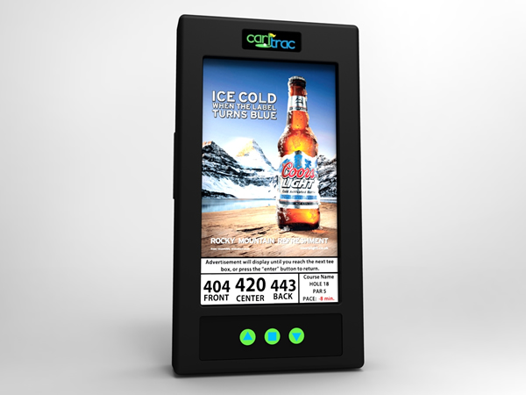
Tapawingo national golf club
Greenside Advertising
Greenside ads cover 80% of the screen and are displayed when the cart approaches the green (roughly 50 yards out from the center of the green). They remain displayed until the cart reaches the next tee box or arrives back to the club house.
2019 Corporate Advertising Package

Slide 7
Tapawingo national golf Club
Advertising Formats
Banner Ads
Dimensions: 480 x 150 pixels
Resolutions: 72 pixels / inch
Format: PNG-8 bit
Greenside Ads
Dimensions: 480 x 650 pixels
Resolutions: 72 pixels / inch
Format: PNG-8 bit
2019 Corporate Advertising Package

Slide 8
Tapawingo national golf club
ADVERTISING PACKAGE
$2,400.00 annually
Includes:
1 Banner & 1 Greenside Ad
Over 1,300,000 Ad Impressions annually
Over 5,500 hours of exposure annually
Annual Cost per Impression: $.00184
Note: Ad Impression numbers and exposure time is base on 27 ads, rotating every 15 seconds
2019 Corporate Advertising Package

Slide 9
TAPAWINGO NATIONAL GOLF CLUB
Agreement
________________________________ _____________________________________
First & Last Name Company Name
________________________________ _____________________________________
Email Phone #
1 year offer $2,400
_____________________________________
2 year offer $4,320 (10% discount) Company Representative Date
3year offer $6,120 (15% discount) _____________________________________
Tapawingo National Date
*Payment options available
Final ads can be sent to dbiedenstein@pga.com
2019 Corporate Advertising Package

